Slide 1
Midterm Review
2025.4.29｜홍찬용
reallygreatsite.com

Slide 2
01
02
03
04
Requirement Specification
Identification of function points and cost estimation
System Architecture
Work Breakdown structure and work schedule
CONTENTS

Slide 3
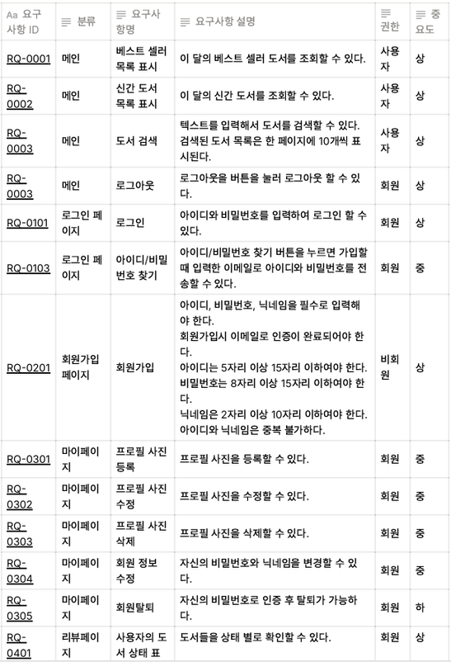
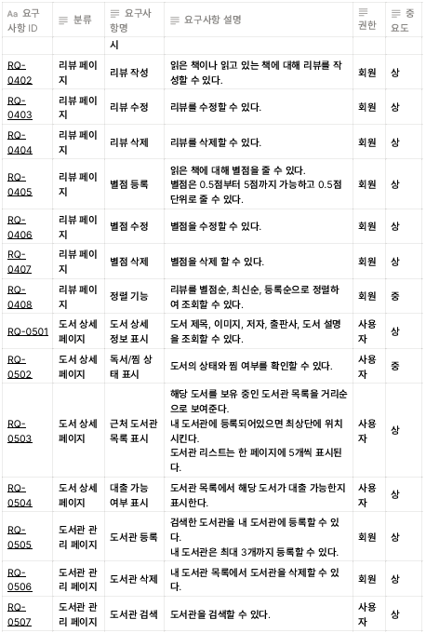
01.
Requirement Specification

Slide 4
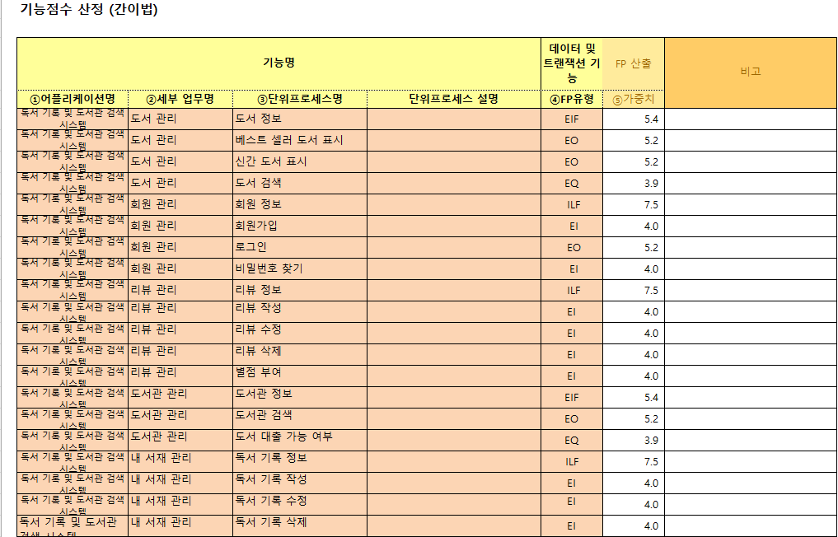
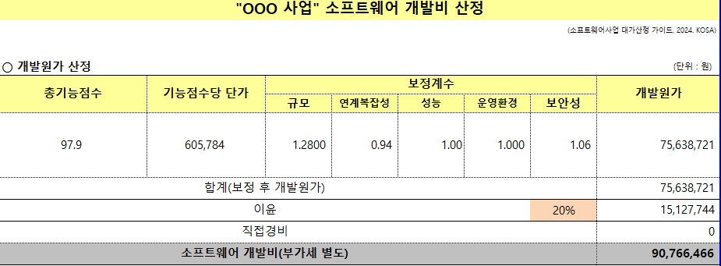
02.
Identification of function points and cost estimation

Slide 5
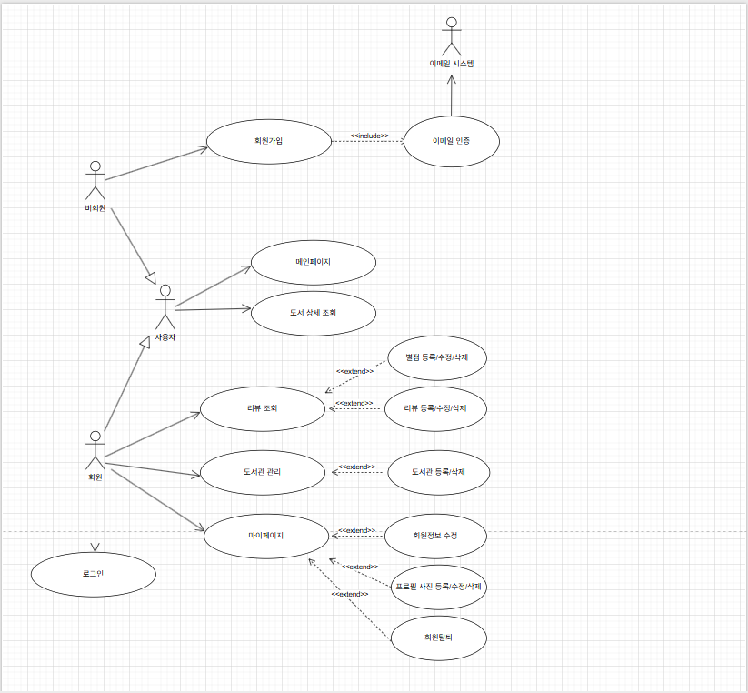
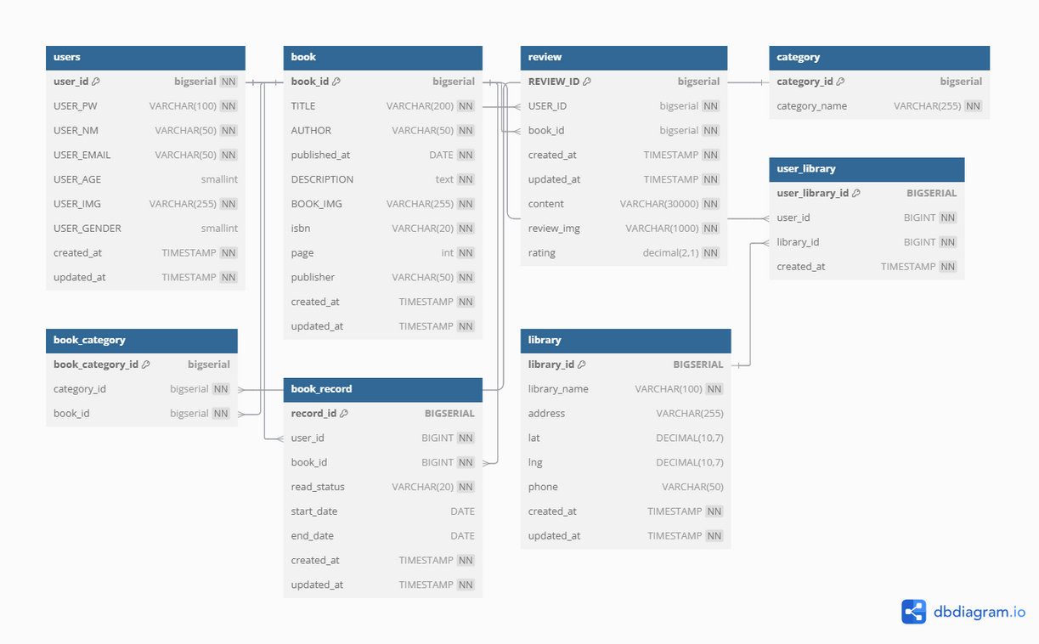
03.
System Architecture

Slide 6
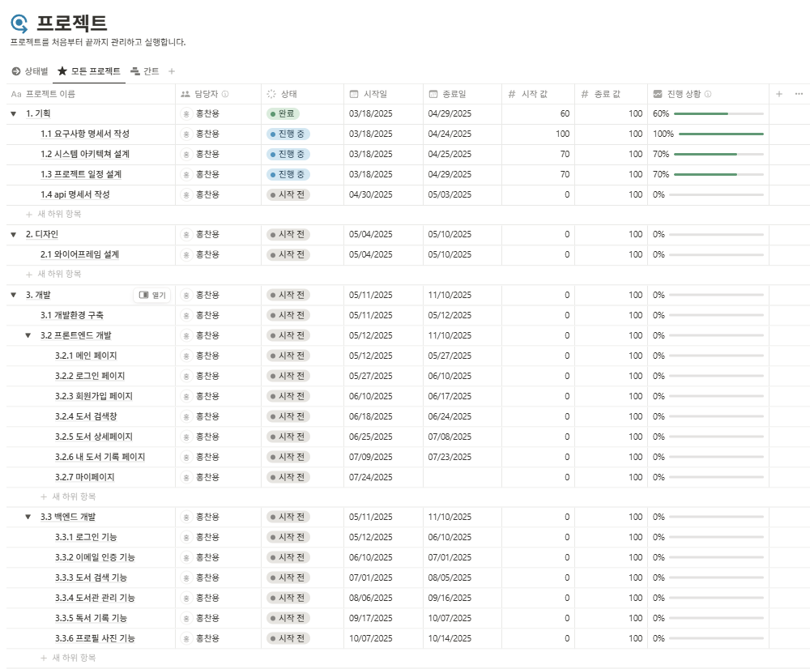
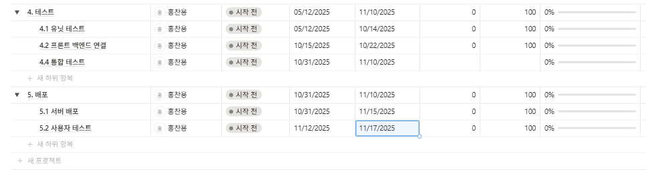
04.
Work Breakdown structure and work schedule

